Slide 1
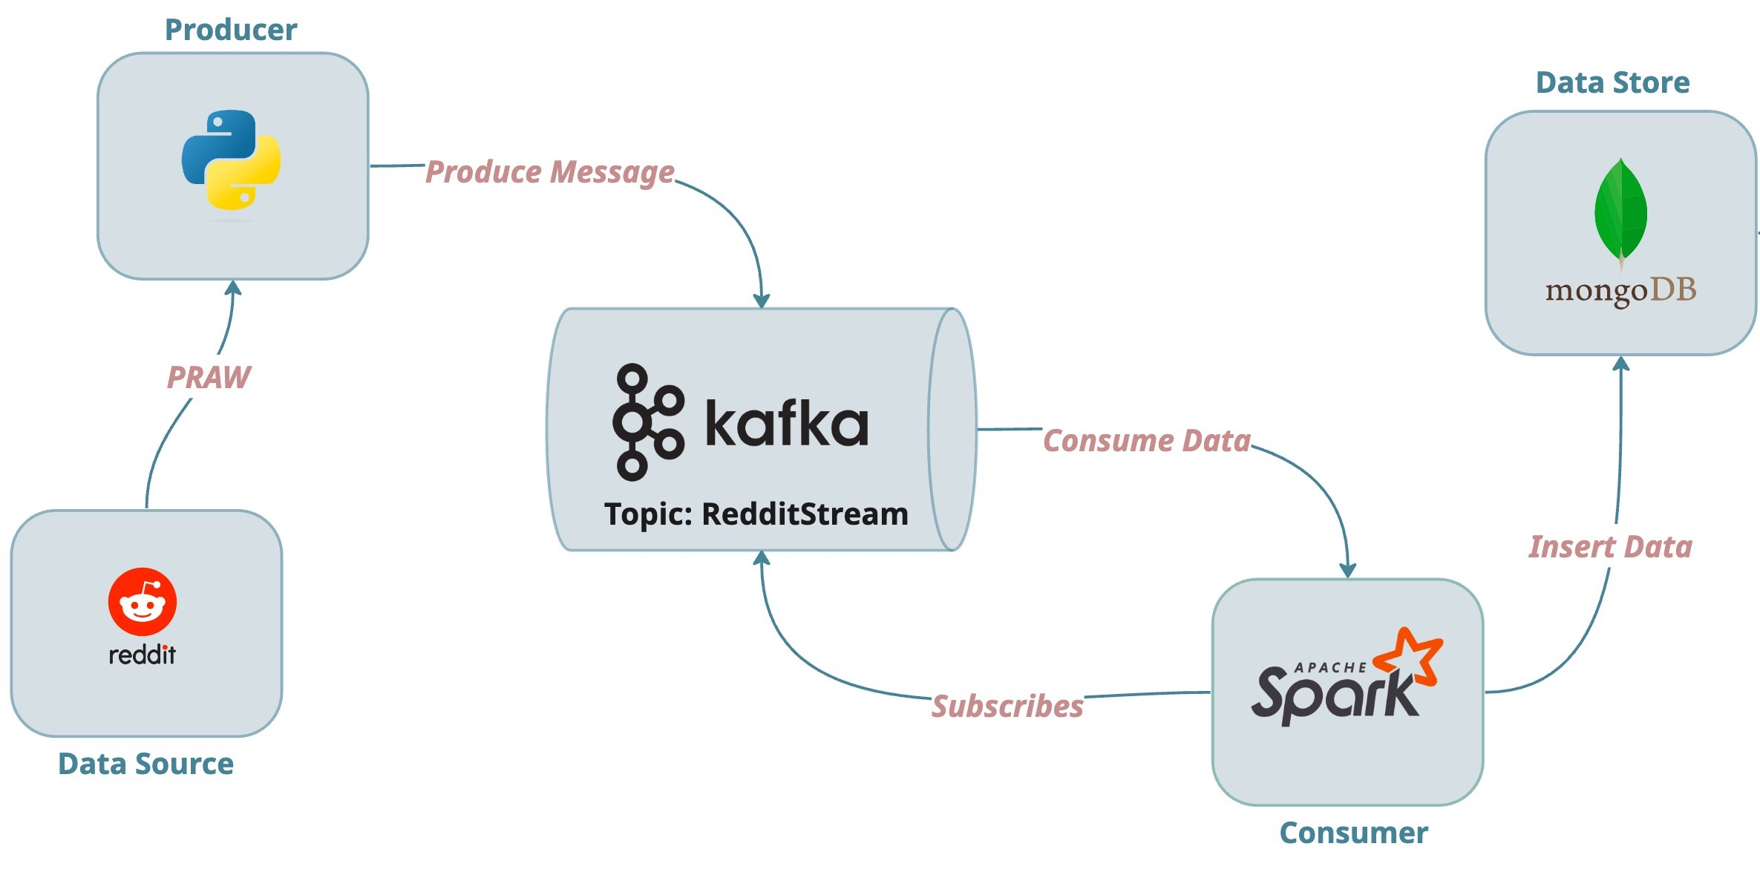
Streaming data from Reddit using Kafka, Spark and MongoDB
Data Engineering Consultant:
Adedamola Oyetayo

Slide 2
Business Problems:
Business Overview & Problems
➢ Business Name: Zipco 1. Industry: Trendwave Marketing Agency
2. success is driven by swift access and understanding of customers behaviour for effective marketing strategies, and a commitment to exceptional customer service.
As the volume of data grows, the current
fragmented system may struggle to keep up,
making it difficult for the agency to scale its
operations.
At Trandwave Agency, the following pressing challenges were encountered within the data processing:
Inefficient Data Processing
Limited Real-Time Analysis
Disparate Datasets:
Inability to Scale
Slow and cumbersome data processing can lead to delays in generating insights, resulting in missed opportunities to engage with consumers effectively.
The inability to analyse data in real-time
restricts the agency's capacity to respond quickly to market changes or consumer trends. This lag can result in lost leads and diminished competitive advantage
When data is stored in silos or is not integrated, it becomes challenging to obtain a holistic view of consumer behaviour.
As the volume of data grows, the current
fragmented system may struggle to keep up, making it difficult for the agency to scale its operations.

Slide 3
Business Objectives & Stack Tools Used
➢ Objectives/ Aims: 1. Real-time Data Collection – Define goals and address challenges in data acquisition.
2. Efficient Data Processing – Evaluate data quality and ensure effective data handling.
3. Data Storage – Manage missing data, outliers, and perform necessary transformations.
4. Scalability – Implement and train predictive models for pricing optimization.
➢Tools:
1. GitHub – Version control and collaboration.
2. PostgresQL: a Relational database to store and manage data files during the ETL process
3. Python – Data analysis, visualization, and machine learning.
4. VS Code/Jupyter notebook – Development and collaboration environment.
5. Tableau: Visualizes data insights and trends, providing dashboards and analytics for stakeholders.
6. Draw.io: Used to design architecture for data processing and entity diagram for data modelling.

Slide 4
System Architecture

Slide 5
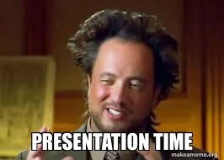
Quick Project Code walkthrough

Slide 6
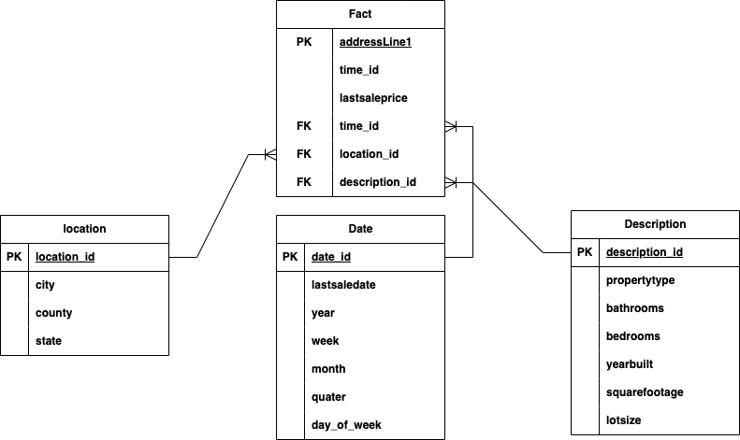
Zipco Data Modeling

Slide 7

Data Pipeline Automation using Crontab

Slide 8
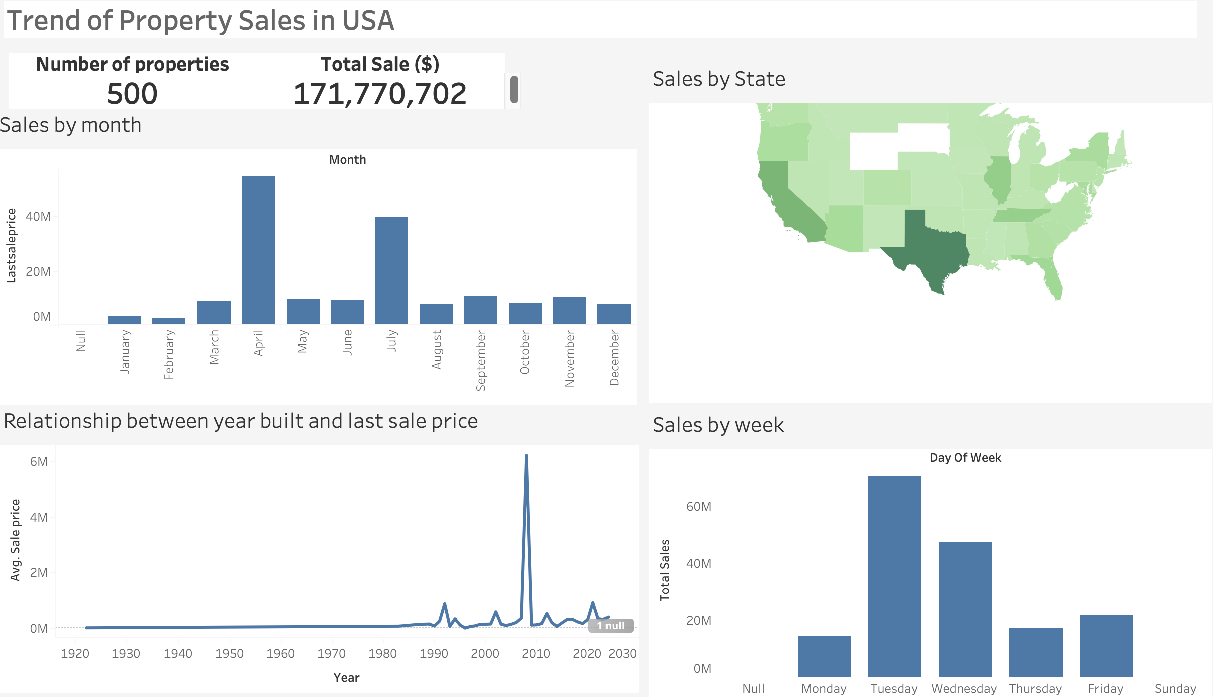
Dashboard

Slide 9
Conclusion: Transforming Data Management at Zipco Real Estate Agency
➢ Implemented a robust ETL pipeline that significantly reduced manual workflows, saving time and resources.
➢ Improved Data Quality: Ensured consistent, accurate, and reliable datasets to support decision-making.
➢ Enhanced Decision-Making: Delivered timely access to critical property and market insights, enabling better strategies and client satisfaction.
➢ Cost Efficiency: Automated processes minimized operational costs, allowing for resource reallocation towards growth initiatives.
➢ Scalable and Future-Ready: Built a secure and scalable system equipped to handle increasing data volumes while maintaining high performance.
➢ Competitive Advantage: Empowered Zipco Real Estate Operation

